Slide 1
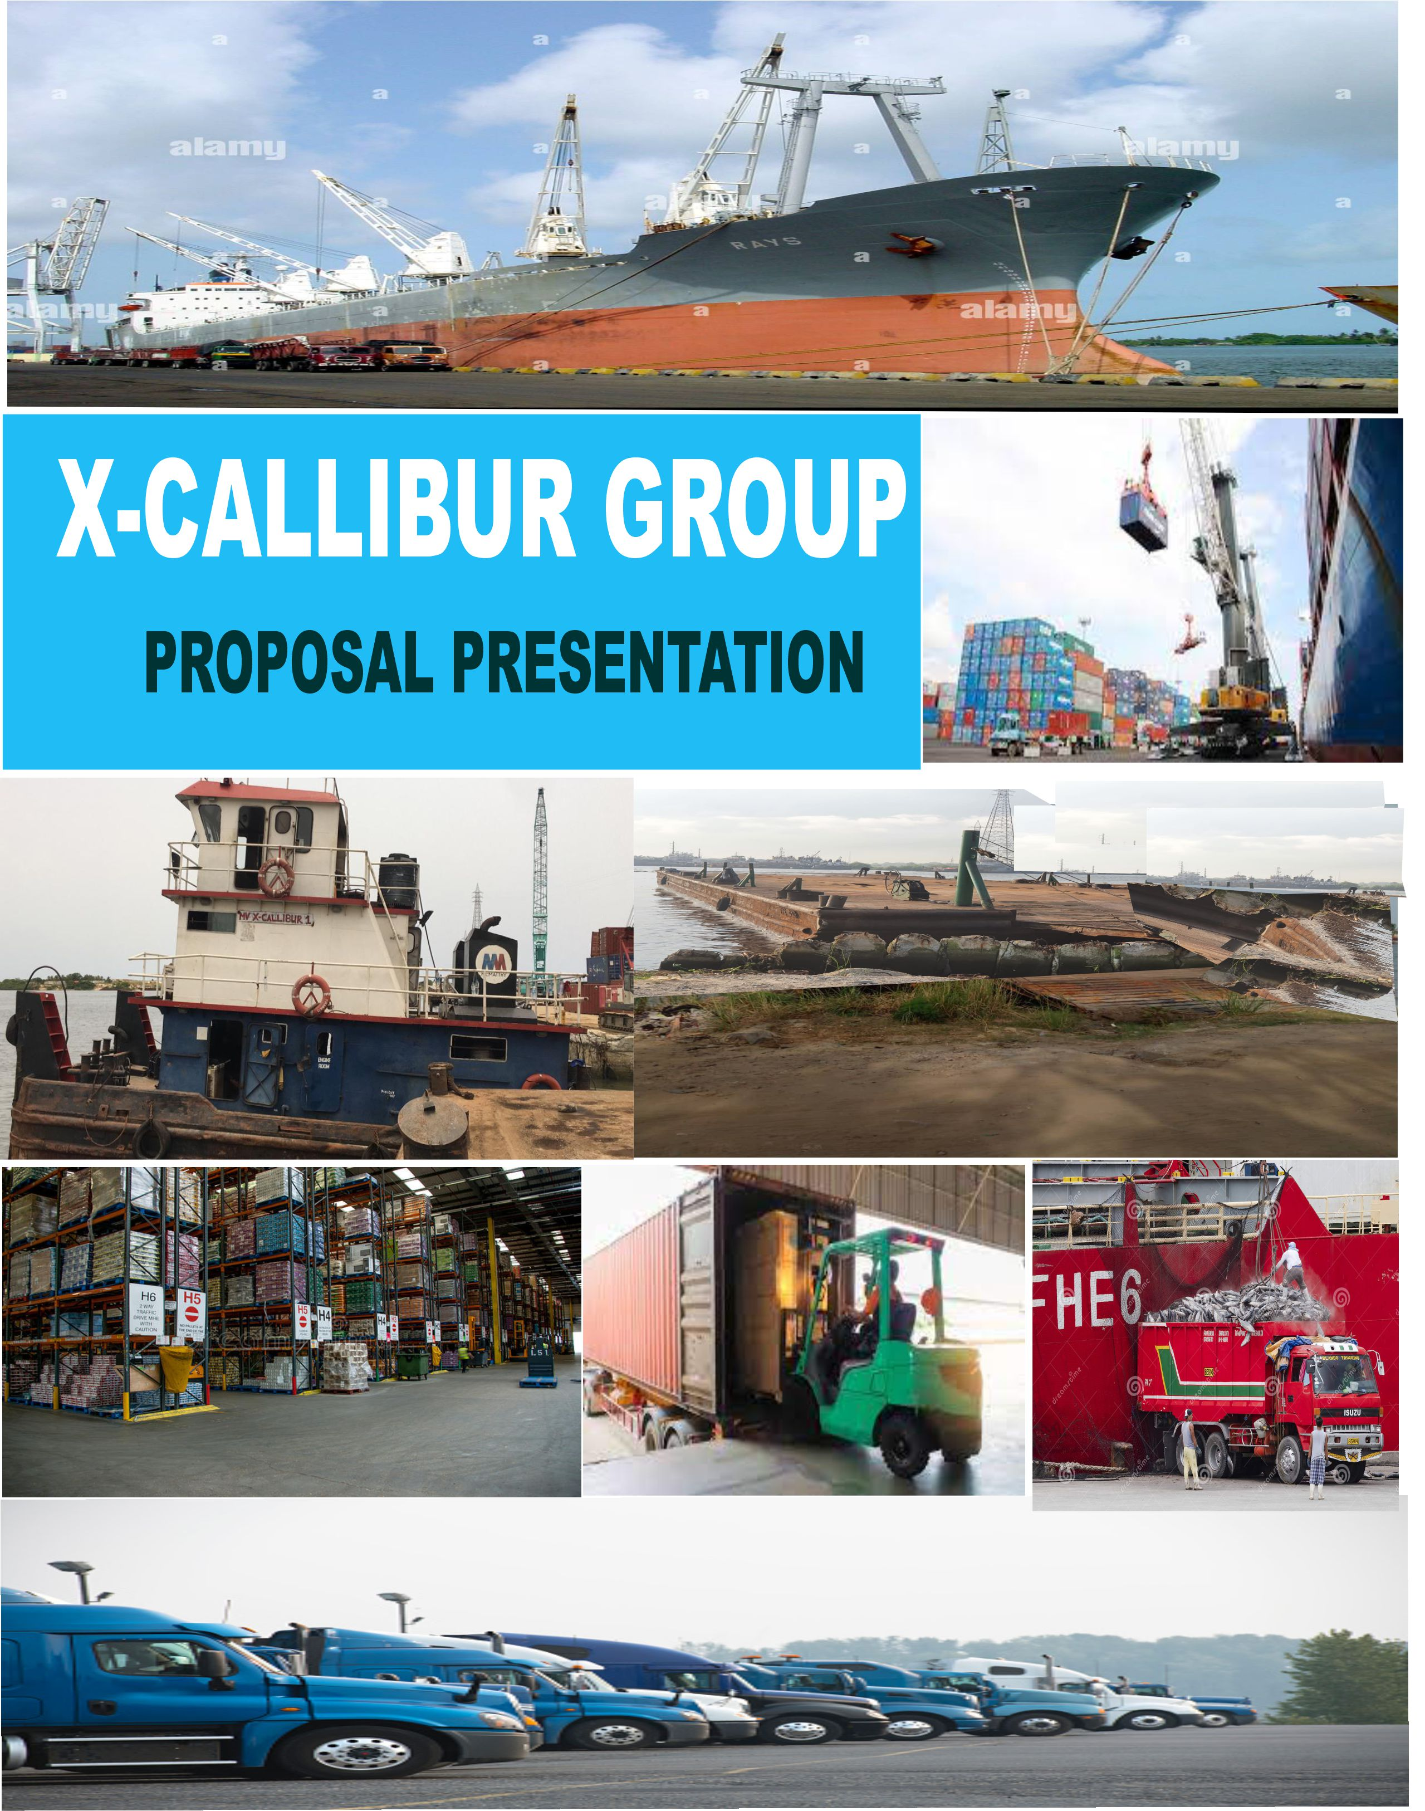


Slide 2
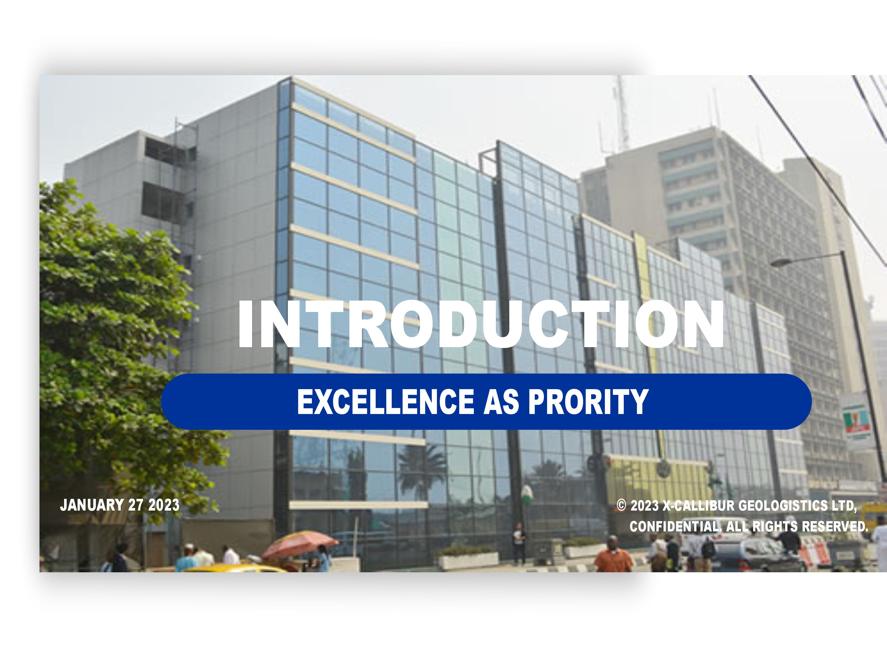

Slide 6
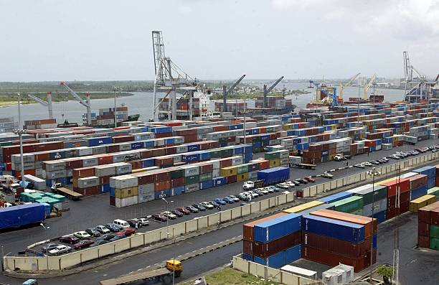
OUR ACHIEVEMENT
Transportation of over 3,000 TUE's for various different shipping line and PARTNERS via barge operation2) Has more that 3 tugboats and barges for creek operation.3) Savaging if wreck shipping with the NAVY FORCE AND NIMASA AGENCY.4) LICENSE SHIPPING COMPANY BY NIMASA5) BARGE OPERATORS LICENSE BY NPA6) MOVEMENT OF VARIOUS HEAVY DUTY CARGO FOR IN AND OUT OF LAGOS AND NIGERIA

Slide 7
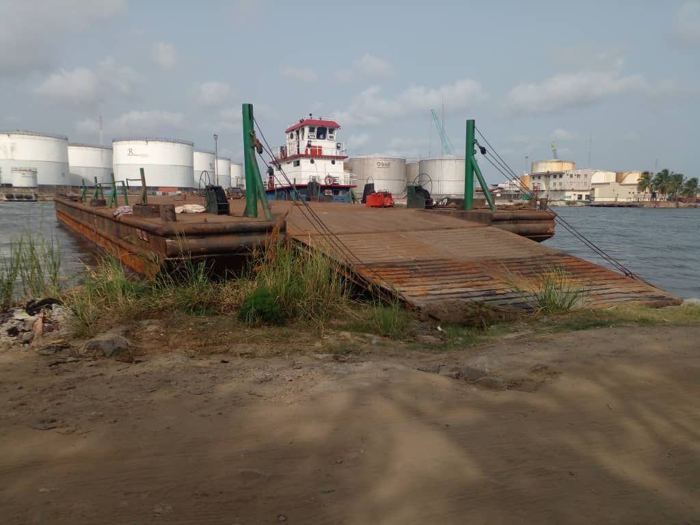
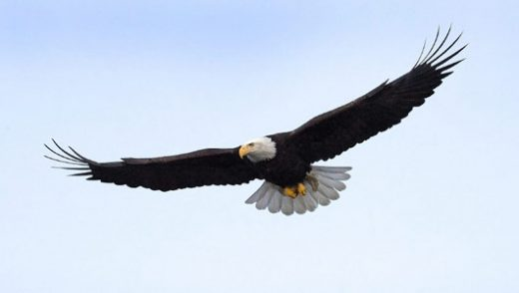
OUR ORGANIZATION
SHIPPING LINES |  | PORT OF CALL
BARGES | TERMINAL IN OPERATION | FLEETS CAPACITY | CONTAINER THROUGHPUT LOADED IN PAST 3YRS
EMPLOYEES | REVENUES MADE IN THE PAST 3YRS. | DELIVERY DESTINATION COVERED IN THE PAST 3 YRS
AGENCIES
LOGISTICS & INTERMODAL

Slide 8
X-CALLIBUR
GEOLOGISTICS
OUR OBJECTIVES IN 2023
Using technology to control/monitor container/cargoes out of port of call to warehouse.
Connecting/updating our customers with real time information of the supply chain operations.
Reducing costs of freight to restore profitability and sustain customers relationship in the freight business .
Building alliances with powerful shipping companies and agencies in the world.
Building the international market hub by connecting local producers in Nigeria with foreign producers to developed our country manufacturing industry.

Slide 9
X-CALLIBUR
GEOLOGISTICS
OUR CORE VALUES
HONESTY
TRANSPARENCY
GOOD TEAMWORK
CREATIVITY
INTEGRITY
OUR VISION
TO RANK TOP AFRICAN HIGH TECH LOGISTICS EXPERTS WITH TOP NOTCH CUSTOMER’S SERVICES, IN BUIDING AFRICAN MARITIME INDUSTRY TO ITS FULLEST.
OUR MISSION
TO PROVIDE EFFECTIVE , EFFICIENT QUALITY HIGH TECH TRANSPORT SYSTEM IN NIGERIA AND BEYOND AFRICA IN THE SUPPLY CHAIN BUSINESS.
ADEQUATE SERVICES RENDERED IN DELIVERY OF EXPORTATION GOODS, SO AS TO HELP NIGERIA GROW ITS ECONOMY RAPIDLY.
TO ACHIEVE A SUSTAINCONTRACTS DEAL ABLE AND RELIABLE SUPPLY CHAIN MANAGEMENT WITH GOOD RESILIENT MANAGEMENT SKILLS OF CUSTOMER’S SERVICES.

Slide 10
OUR MANAGEMENT BOARD

Slide 11
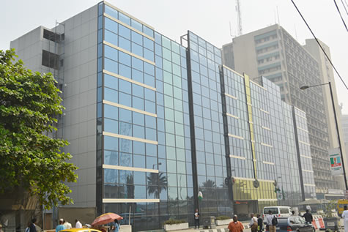
X-CALLIBUR
GEOLOGISTICS
OUR SOLUTION
X-Callibur Geologistics offers full range solutions to intermodal/multimodal problems by rendering our services adequately as stated below:
Give good daily barging services in the waterways and controlling of all daily activities/ monitoring of goods from port of call to its various destinations.
Adequate supply of marine equipment where it’s needed.
Adequate free flow of environment with good “intermodal policy”.
Gives best profitable inland freight price with high tech monitoring device.
Making sure all equipment/ goods are well checked before delivery.

Slide 12
X-CALLIBUR
GEOLOGISTICS
OUR SUPPLY CHAIN MANAGEMENT
OUR MANAGEMENT TEAM HAVE GOOD WELL TRAINED EXPERIENCE IN SUPPLY CHAIN LOGISTICS MANAGEMENT. THEY ARE CAPABLE EVERY FREIGHT OPERATIONS SERVICES SUCH AS WATERWAYS/INLAND FREIGHT LOGISTICS, MARINE EQUIPMENT SUPPLIES, MARINE CONSULTATION , WAREHOUSING , CUSTOM CLEARING/DOCUMENTATION , AIR FREIGHT, TECHNOLOGY, PO MANAGEMENT, INDUSTRIAL PROJECTS AND SUPPLY CHAIN SOLUTIONS.

Slide 13
OUR CONTACT

